Slide 1
Samarkand, 24 June 2025

Slide 2
RATIONALE & BACKGROUND
Governments play a pivotal role in delivering public services and achieving SDGs.
In the present context the development of robust e-government infrastructures and ecosystems is becoming increasingly critical.
A joint effort is needed to harness new, often disruptive technologies and digital governance mechanisms for
promoting efficient and trustworthy public service delivery
contributing to sustainable development and more inclusive societies.

Slide 3
RATIONALE & BACKGROUND
Overtime, the CADGov Forum has potential to promote
Increased Capacity.
Strengthened capacity of government officials to plan, implement, and manage e-government initiatives at both the national and regional levels.
Enhanced Collaboration.
Improved regional cooperation and coordination in the development and implementation of digital governance strategies.

Slide 4
RATIONALE & BACKGROUND
THE CADGov Forum aims at joining forces and institutions in Central Asia in order to
Share experiences, best practices, and challenges
Foster synergies and partnerships
Articulate digital governance development initiatives at different levels in the region
Promote the design and assessment of regional and national strategies for digital governance and citizen empowerment in the region
Bring this experience and potential to the international arena

Slide 5
NEXT STEPS
Alice: Would you tell me, please, which way I ought to go from here?
The Cheshire Cat: That depends a good deal on where you want to get to.
Lewis Carroll, Alice’s Adventures in Wonderland, 1865

Slide 6
NEXT STEPS
Build a network
Q: How to reach out / involve digital transformation National Agencies / Ministries?
Q: Other stakeholders?
Q: …
Analyse / Document /Propose
Q: Contact / involve Governments after the CADGov launching event today?
Q: Prepare a White Paper / Policy Brief on the current challenges in this area in Central Asia?
Q: …

Slide 7
NEXT STEPS
Foster synergies
Q: Promote a e-meeting with the relevant agencies in Central Asia on this topic?
Q: Launch a series of regular webinars on relevant topics
(e.g. from citizen-centric services to agential AI)?
Q: …
Set up a coordination structure
Formally chaired by HE the Minister of Digital Technologies of Uzbekistan
Q: …

Slide 8
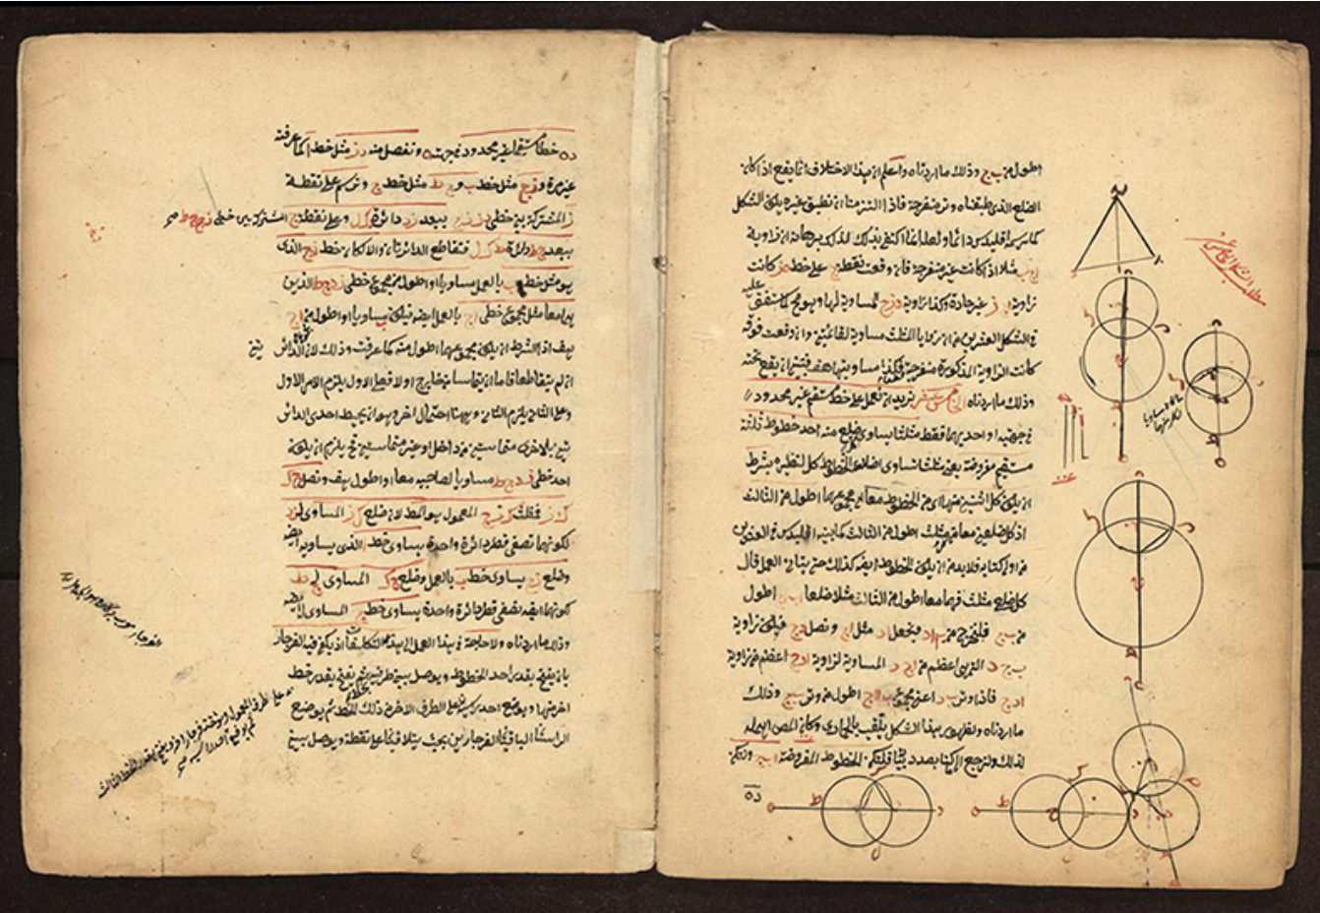
Bringing to digital governance
the spirit of Samarkand
A stance of logic rigour
A meeting point of cultures and practices
Sharḥ ashkāl al-ta’sīs, Ṣalāh al-Din Mūsā ibn Muḥammad,
known as al-Rūmī, 1412

